Slide 1
DevOps

Slide 2
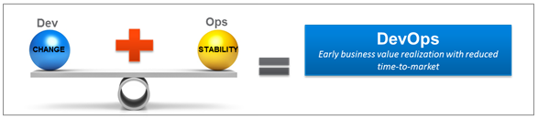
DevOps

Slide 3
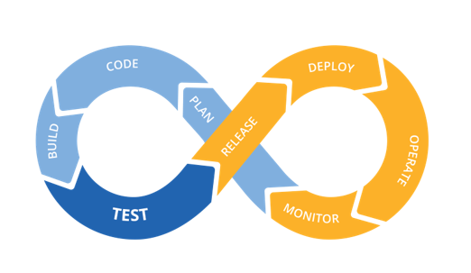
What is DevOps ?
DevOps is a practice of optimizing development and operations activities through structured processes, automation and collaboration. It aims to synergize processes between development and operations teams to make them more efficient.

Slide 4
DevOps emerged out of the need to deliver faster and better software and services
DevOps is about
Dev and Ops working as one team
Common goal, common metrics and single process
Unified tooling and no-touch automation
Speed
Quality
Increased support efficiency

Slide 5
Why DevOps ?
In delivering quality software to valuable customers, Dev and Ops are in conflict with each other.
Dev expects need for change as development works on new features, bug fixes etc.., and they want the changes rolled out quickly to production.
Once the Software is delivered, the Operation Department avoids changes to ensure stability.
Dev
DevOps
Ops
Business

Slide 6
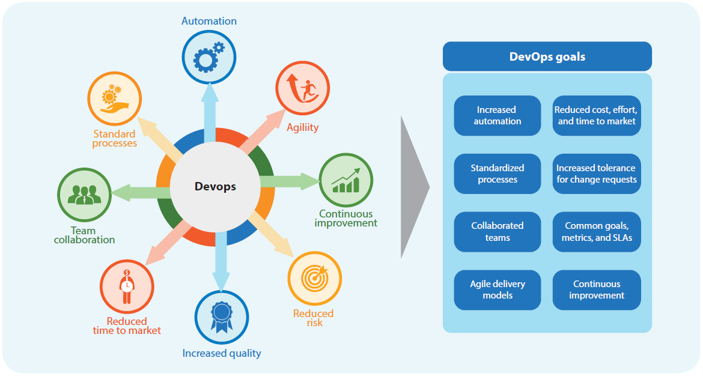
Key DevOps Goals

Slide 7
DevOps Pipeline
Deployment
Operations &
Monitoring
Planning
Build
Test
Release
Agile Development
Continuous Integration
Continuous Deployment
DevOps

Slide 8



DevOps Challenges
Successful implementation in any organization can be attributed to the 3 key parameters - People, process and Technology.
People – Why is it difficult to make Dev and Ops teams work closely?Dev and Ops are part of different hierarchal structure within the organization having different vision and mission; Distributed team across geographies add to the complications.
Process – What are the challenges in current processes that stops Dev and Ops to have rapid releases? Traditional processes demands formal handovers which hinder rapid deployment; Both teams have different set of SLAs and metrics.
Technology - What is a problem with technology and tools adoption?Lack of Automation, Insufficient and inconsistent Infrastructure, Inconsistency in performance metrics measured, usage of different tools, etc.

Slide 9
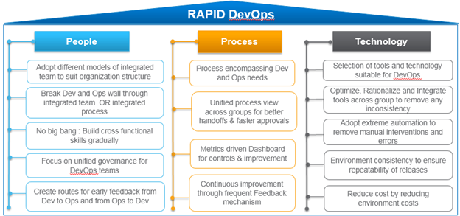
Infosys DevOps

Slide 10
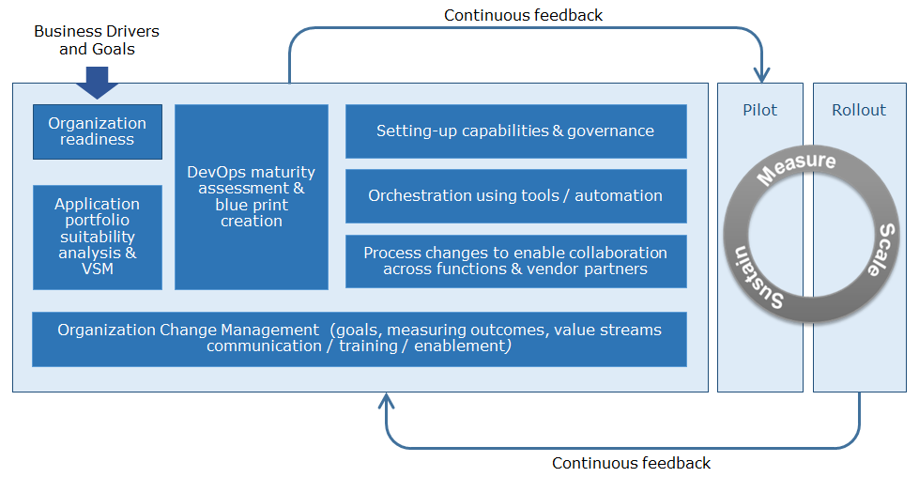
Transformation roadmap by Infosys

Slide 11
…through Infosys DevOps services and capabilities
Infosys Services
450+
Tools specialist / DevOps consultant
On the Rise
DevOps Client engagements
Consulting
Readiness Assessment
Roadmap definition & transformation
Scalable DevOps
DevOps process consulting
Ready-to-use
Continuous delivery pipelines, IPs,
Platforms and DevOps labs
Project Execution
DevOps project execution
Tools and products evaluation
Tools and accelerators implementation
Continuous delivery setup
Organization change management
10K
Experienced CI –CD tools professionals
Multiple
Vendor Alliances

Slide 12
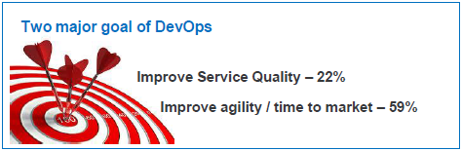
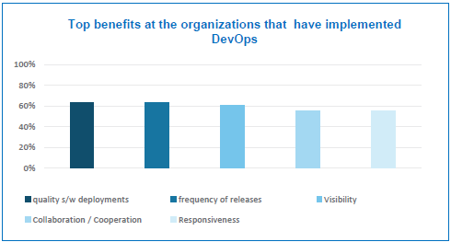
DevOps Benefits
Speed
Rapid Delivery
Reliability
Scale
Improved Collaboration
High performing respondents (implemented DevOps for > 12 months) are able to:
Achieve 52% performance improvement
Deploy code 30 times more often & 8000 times faster
Double the change success rate
Restore service 12times faster

Slide 13
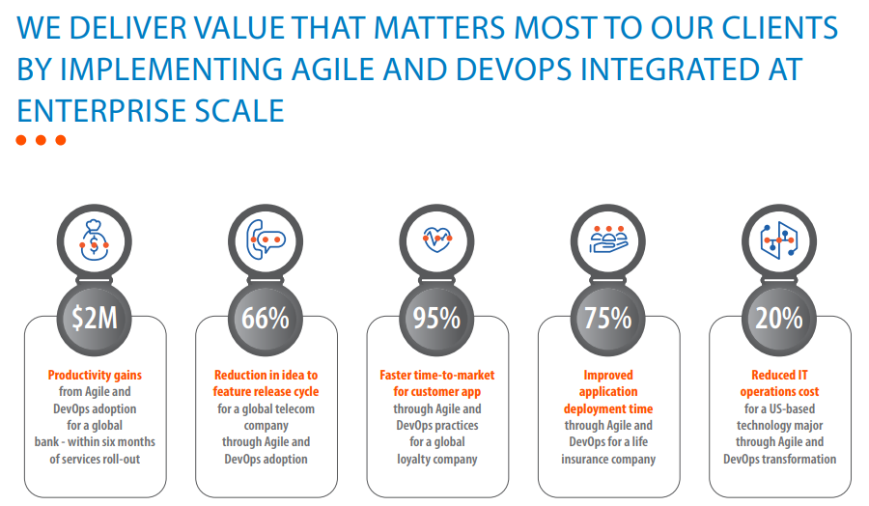
We deliver value that matters most to our clients by implementing agile and devops integrated at enterprise scale

Slide 14
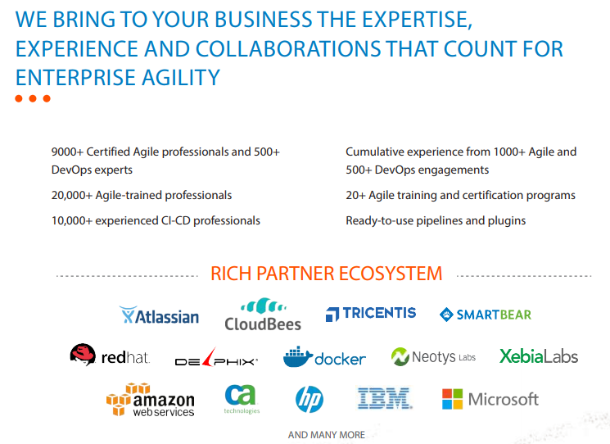
We bring to your business the expertise, experience and collaborations that count for enterprise agility

Slide 15
THANK YOU

